Slide 1
Prediction of Drug-Drug Interaction Potential Using Machine Learning Approaches
Joseph Scavetta
Department of Computer Science
Rowan University
May 12th 2020

Slide 2
Drug Development Challenges
Pre-clinical
Clinical Trials
Approval and Monitoring
Drug Discovery
Phase I
Safety
Healthy
Phase II
Safety
Efficacy
Phase III
Diverse patients
FDA Review
Phase IV
Candidate
Compounds
# Volunteers
10 – 100
50 – 500
+1000s
3 – 6 years
6 – 7 years
0.5 – 2 year
∞
$2.6 billion per compound
Drug development can take over ten years from start to approval
Many candidate compounds are tested for one successful drug
Harmful drugs can still make it through clinical trials

Slide 3
Why Drugs Fail ?
Phase I
Most drugs fail due to toxicity
Phase II and Phase III
Often fail due to efficacy problems
Toxicity still plays a role
Toxicity is a crucial indicator for the success of a drug
Two types of failures
Unavoidable due to lack of knowledge on underlying chemistry or biology
Preventable through optimal study designs, dosages, and safety data
Learning from earlier mistakes can reduce avoidable failures
Developing new models can improve unavoidable failures
D. Schuster, C. Laggner, and T. Langer, “Why Drugs Fail - A Study on Side Effects in New Chemical Entities,” Curr. Pharm. Des., vol. 11, no. 27, pp. 3545–3559, Oct. 2005.

Slide 4
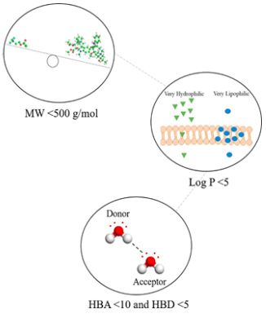
Drug Candidate Optimization
Which physiochemical properties, and which values, should we expect from a safe and efficacious drug?
Rule-based (Lipinski's rule of 5)
Upper bounds on H-bond donors and acceptors, molecular mass, lipophilicity
Discrete cutoffs; does not consider the property distributions in non-drugs
Relative drug likelihood (RDL)
Compare successful drugs with non-drugs using Bayesian methods
Identify properties that give greatest distinction between two sets
Still tends to fail at capturing the complexity
Emerging approaches
Machine Learning and artificial intelligence

Slide 5
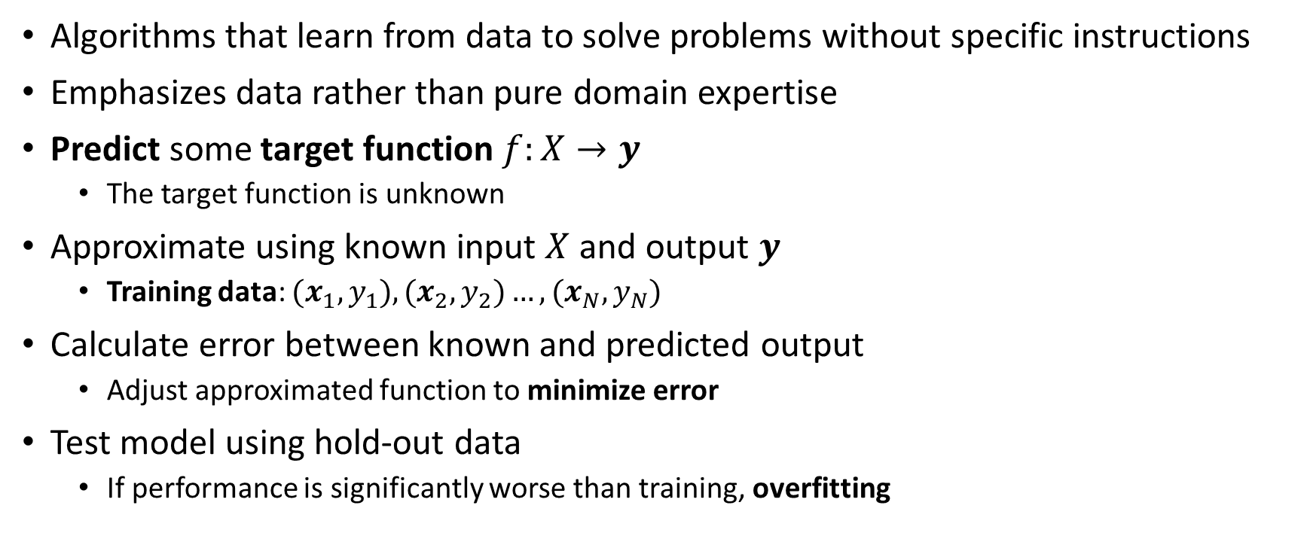

Machine Learning Overview
Algorithms that learn from data to solve problems without specific instructions
Emphasizes data rather than pure domain expertise
Predict some target function $f:X→y$
The target function is unknown
Approximate using known input $X$ and output $y$
Training data: $(x_{1},y_{1}),(x_{2},y_{2})…,(x_{N},y_{N})$
Calculate error between known and predicted output
Adjust approximated function to minimize error
Test model using hold-out data
If performance is significantly worse than training, overfitting
y
$$f$$
x
Error

Slide 6

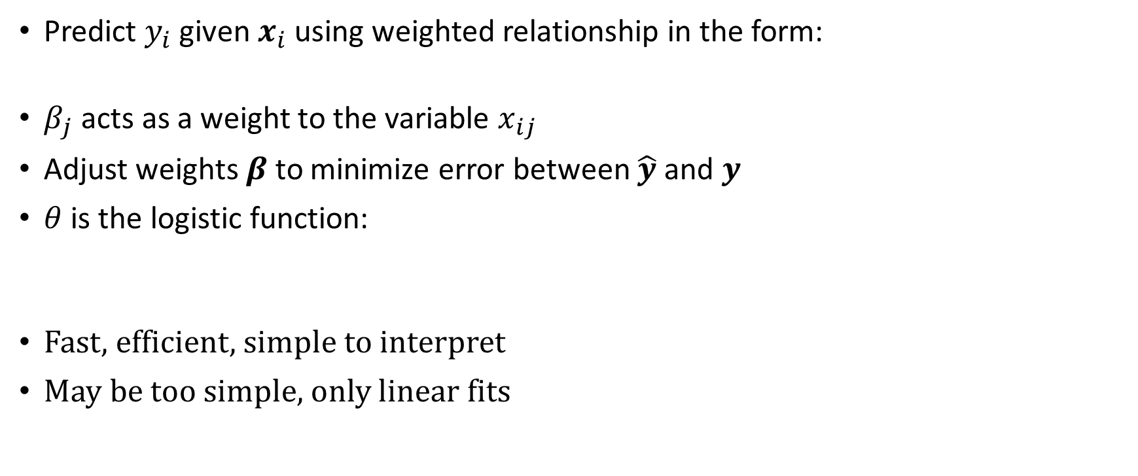

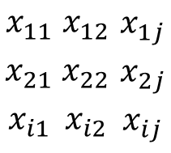
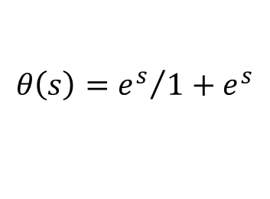
Linear Models: Logistic Regression
Predict $y_{i}$ given $x_{i}$ using weighted relationship in the form:
$β_{j}$ acts as a weight to the variable $x_{ij}$
Adjust weights $β$to minimize error between $\hat{y}$and $y$
$θ$ is the logistic function:
Fast, efficient, simple to interpret
May be too simple, only linear fits
Features
$${\hat{y}}_{i}=θ(β_{0}+β_{1}x_{i1}+⋯+β_{j}x_{ij})$$
$$x_{11}$$ | $$x_{12}$$ | $$x_{1j}$$
$$x_{21}$$ | $$x_{22}$$ | $$x_{2j}$$
$$x_{i1}$$ | $$x_{i2}$$ | $$x_{ij}$$
$$y_{1}$$
$$y_{2}$$
$$y_{i}$$
Samples
1
$$θ\left(s\right)={e^{s}}/{1+e^{s}}$$
0

Slide 7



Decision Trees
Induction rules from empirical data
Using decision points, split samples based on values
Branch nodes that split paths
Leaf nodes that act as the outcome
Order most informative features at the top
Split the data into separable classifications down the tree
Information gain
Achieve high accuracy on training
Prone to overfitting, bad generalization
True
$$x_{1}<6$$
False
Class 1
$$x_{3}>8$$
True
False
$$x_{2}<1$$
Class 2
True
False
Class 2
Class 1
Entropy

Slide 8




Ensemble Models: Random Forests
Ensemble of decision trees
Bootstrap aggregation (bagging)
sub-sample the original dataset
sample with replacement
Sub-sample features for each tree
Collectively predict by selecting the majority
Top performer on many tasks
Less sensitive to overfitting
Interpretable
$$x_{1}$$
$$x_{2}$$
$$x_{3}$$
$$x_{4}$$
{ , , , }

Slide 9
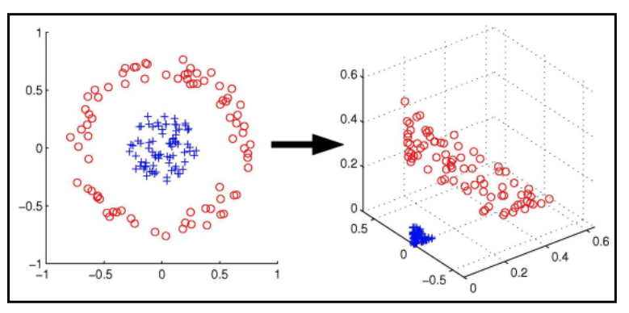
Support Vector Machine
Find optimal hyperplane that maximizes distance between classes
Always finds the optimal solution
Model stability
Robustness from overfitting
If data is not linearly separable, project into higher dimension
allowing data to become linearly separable

Slide 10



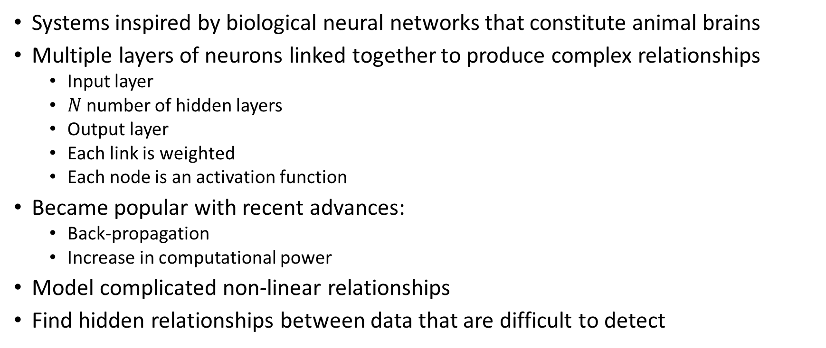





Artificial Neural Network
Systems inspired by biological neural networks that constitute animal brains
Multiple layers of neurons linked together to produce complex relationships
Input layer
$N$ number of hidden layers
Output layer
Each link is weighted
Each node is an activation function
Became popular with recent advances:
Back-propagation
Increase in computational power
Model complicated non-linear relationships
Find hidden relationships between data that are difficult to detect
$$f$$
$$f$$
$$f$$
$$f$$
$$f$$
$$f$$
$$f$$
$$f$$
Input Layer
Hidden Layer
Hidden Layer
Output Layer

Slide 11
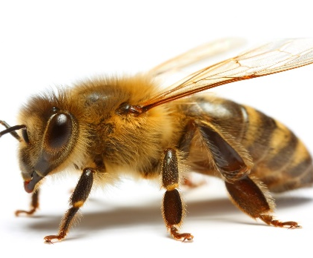
Convolution Neural Network
Subset of deep learning
Convolution Neural Networks (CNNs) use layers of convolution kernels
Convolution kernels look at a sub-sample of input neurons to generate an output
Can use multi-dimensional layers
Learns image filters without extensive feature-engineering on the input
Less computational overhead compared to a fully connected network

Slide 12
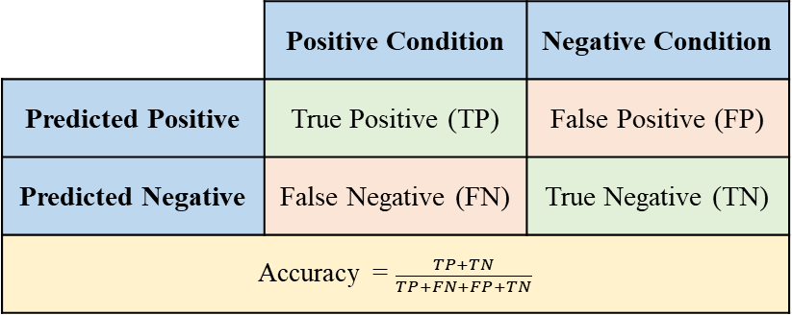
Metrics and Workflows
Model bias
High bias: could not train a good model to the dataset
Underfitting
Evaluate the model with training data
Model variance
High variance: new data is not predicted well
Overfitting
Evaluate the model with unseen data
Cross-validation
Train and test the model while rotating data
Size of test set depends on amount of folds
All data will be used in testing set once
 | Positive Condition | Negative Condition
Predicted Positive | True Positive (TP) | False Positive (FP)
Predicted Negative | False Negative (FN) | True Negative (TN)
Accuracy = $\frac{TP+TN}{TP+FN+FP+TN}$
Train Test

Slide 13
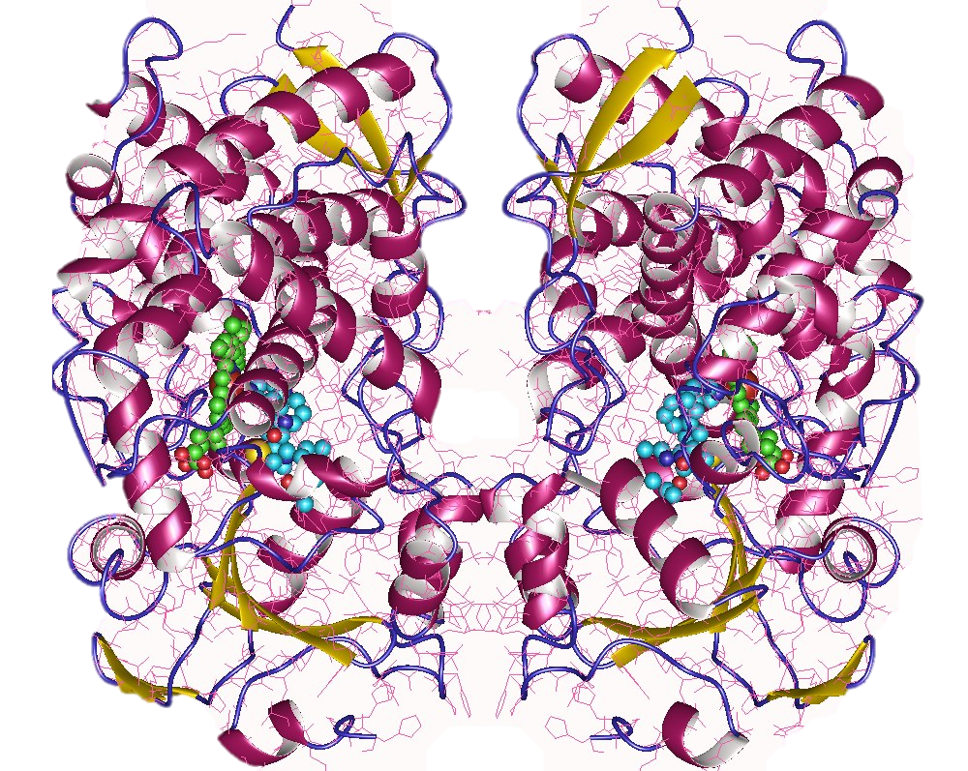
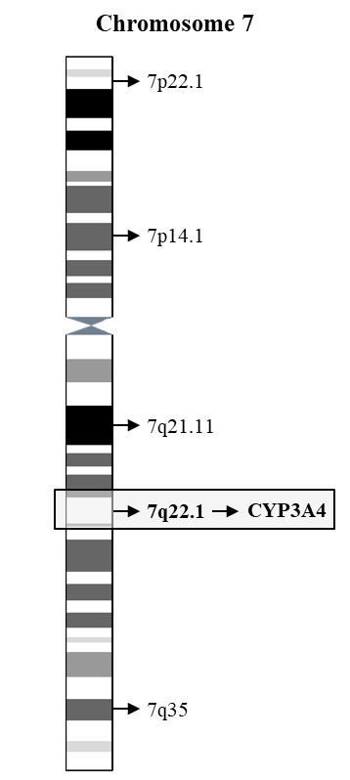
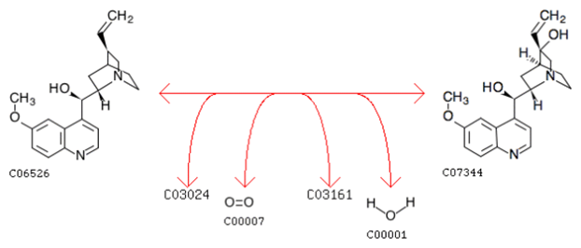
Cytochrome P450 Enzymes
Cytochrome P450 Superfamily
Heme-containing enzymes
Function as monooxygenases (reducing oxygen to hydroxyl)
57 human isoforms described
Mediates 90% of oxidative metabolism
Metabolize ~75% of drugs
CYP3A Sub-family
Mainly found in liver and intestines
Catalyzes 46% of xenobiotic oxidations
Consists of 4 genes: CYP3A4, CYP3A5, CYP3A7, and CYP3A43
CYP3A4 has highest expression and affinity for metabolizing drugs
F. J. Gonzalez and H. V Gelboin, “Human cytochromes P450: evolution and cDNA-directed expression.,” Environ. Health Perspect., vol. 98, pp. 81–5, Nov. 1992

Slide 14
Potential for Drug-Drug Interactions
The reliance on P450 enzymes to oxidize and facilitate the removal of drugs opens the potential for issues in drug metabolism
Induction can reduce bioavailability of drugs
Inhibition can accumulate drugs to toxic levels
26% of 2M adverse events attributed to drug-drug interactions
Can be predicted and avoided

Slide 15
Screening for CYP3A4 Inhibitors
CYP3A4 inhibitition potential can be assessed in vitro by using a probe substrate
Probe is placed in mixture of CYP3A4 enzymes and drugs under investigation
If drug inhibits CYP3A4, probe can no longer be metabolized at its standard rate
Fluorescent probe or Liquid Chromatography Mass Spectrometry for large scale
Probe
Metabolite
Probe
CYP3A4
CYP3A4
Drug
Drug

Slide 16
Inhibition Model Review
Authors | Date | Model | Val | Acc | # Inhibitors | # Non | Feature Set
Wu et al. | 2019 | XGBoost | CV | 0.860 | 3070 | 5985 | PaDEL1&2D, PubChem FP
Wu et al. | 2019 | Gradient Boosting Decision Tree | CV | 0.851 | 3070 | 5985 | PaDEL1&2D, PubChem FP
Wu et al. | 2019 | Deep Neural Network | CV | 0.839 | 3070 | 5985 | PaDEL1&2D, PubChem FP
Wu et al. | 2019 | Convolutional Neural Network | CV | 0.833 | 3070 | 5985 | PaDEL1&2D, PubChem FP
Wu et al. | 2019 | Random Forest | CV | 0.828 | 3070 | 5985 | PaDEL1&2D, PubChem FP
Li et al. | 2018 | Multitask Auto Encoder Deep Neural Network | CV | 0.850 | 3070 | 5985 | PaDEL1&2D, PubChem FP
Li et al. | 2018 | Singletask Auto Encoder Deep Neural Network | CV | 0.845 | 3070 | 5985 | PaDEL1&2D, PubChem FP
Lee et al. | 2017 | Multiclass Laplacian-Modified Naïve Bayes | Test | 0.799 | 1193 | 2221 | VolSurf+
Su et al. | 2015 | Support Vector Machine | Test | 0.756 | 5177 | 7456 | PaDEL3D, Mold
Su et al. | 2015 | C5.0 Decision Tree | Test | 0.733 | 5177 | 7456 | PaDEL3D, Mold
Sun et al. | 2011 | Support Vector Machine | CV | 0.811 | 2334 | 4466 | Custom Atom types
Cheng et al. | 2011 | Support Vector Machine | CV | 0.775 | 4637 | 6899 | MACCS
Cheng et al. | 2011 | Stacked: SVM; K-NN | CV | 0.767 | 4637 | 6899 | MACCS
Cheng et al. | 2011 | Stacked: SVM; Naïve Bayes | CV | 0.752 | 4637 | 6899 | FP4

Slide 17
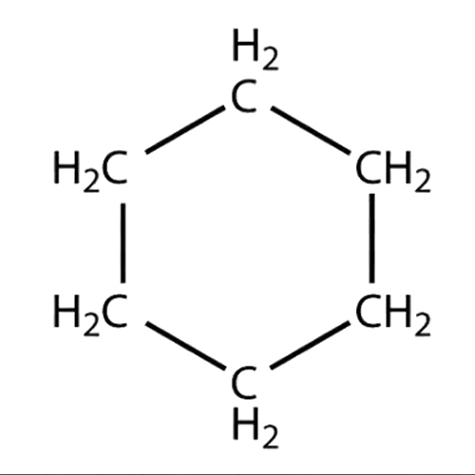
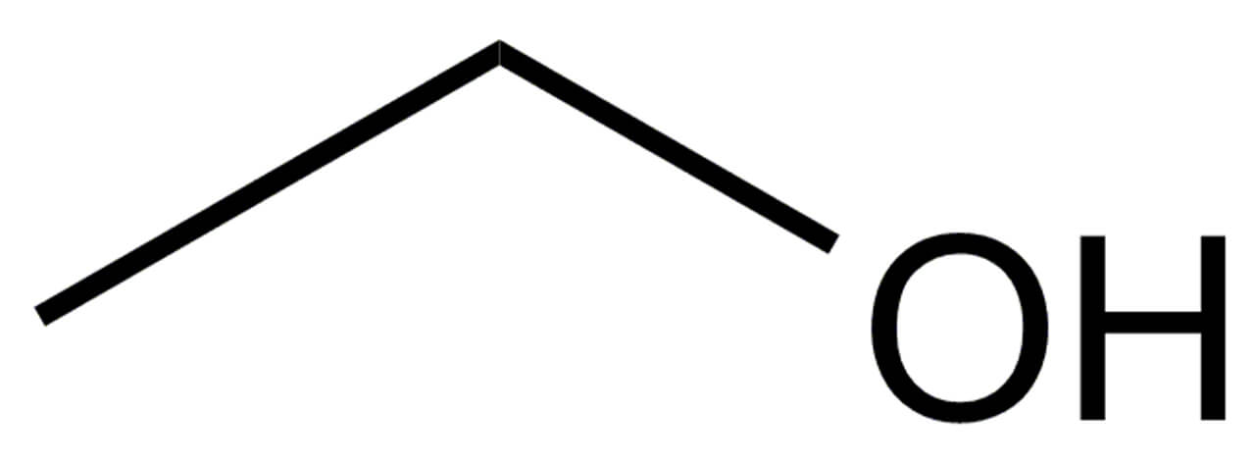
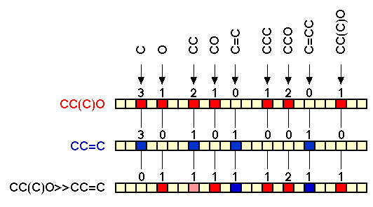
Compound Featurization
Cyclohexane
Ethanol
Simplified Molecular-Input Line-Entry System (SMILES)
Model a compound using a single line of characters
Molecular Fingerprints
Compounds are represented as a string of integers
Typically represent presence or absence of substructure
Molecular Descriptors
Compute chemically relevant data from compound structures
Solubility, acidic properties, electrostatic properties, etc.
Examples: PaDEL-Descriptor and Mordred
CCO
c1ccccc1
D. Weininger, “SMILES, a chemical language and information system. 1. Introduction to methodology and encoding rules,” J. Chem. Inf. Model., vol. 28, no. 1, pp. 31–36, Feb. 1988.

Slide 18
Cytochrome P450 3A4 Inhibitor Modeling
Standard Models
Retrieve AID: 1851
using PubChem API
Mordred
Generate Features
PubChem Fingerprints
Clean and Label Data
Imputation
Hyperparameter Optimization
Normalization
Low Variance Removal
Class Balance
Logistic Regression
Train Models
Support Vector Machine
Random Forests
Neural Network
Novel Models
SMILE Auto-Extraction
Train Models
2D Auto-Extraction

Slide 19
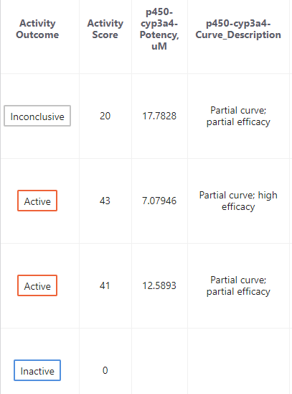
Dataset Curation
PubChem AID: 1851*
Publicly available, 17,143 compounds tested in vitro
Dealkylation of pro-luciferin to luciferin; luciferin detected with luminescence
Mesaured concentration−response curves
PubChem RESTful API (HTTPS protocol)
10,832 compounds, 1,826 molecular features, and 881 fingerprint bits
PubChem AID: 1851
Activity scores
activity score ≥ 40
complete curve or high efficacy
Inhibitors
PubChem fingerprints
PaDEL
Curves
Molecular features
activity score = 0
Non-inhibitors
Mordred
SMILES
*https://pubchem.ncbi.nlm.nih.gov/bioassay/1851

Slide 20
Cytochrome P450 3A4 Inhibitor Modeling
Standard Models
Retrieve AID: 1851
using PubChem API
Mordred
Generate Features
PubChem Fingerprints
Clean and Label Data
Imputation
Hyperparameter Optimization
Normalization
Low Variance Removal
Class Balance
Logistic Regression
Train Models
Support Vector Machine
Random Forests
Neural Network
Novel Models
SMILE Auto-Extraction
Train Models
2D Auto-Extraction

Slide 21
Preprocessing and Hyperparameters
Preprocessing
Mean impute missing data
Normalize features to fall within 0 – 1
Remove features with a variance < x ∈ [0, 0.25]
Balance classes
Synthetic Oversampling (SMOTE)
Under-sampling
Leave unbalanced
Model hyperparameters
Cross-Validated Pipeline
Pre-processors trained with training set
Applied to the testing set
Model | Hyperparameter | Range Considered | Best Value
Logistic Regression | Balance | {None, Under-sample, SMOTE} | None
 | Variance Threshold | [0, 0.25] | 0.00164
 | C = 1 / regularization | [1x10⁻⁵, 1x10⁵] | 44772.5
Random Forests | Balance | {None, Under-sample, SMOTE} | SMOTE
 | Variance Threshold | [0, 0.25] | 0.02322
 | Max Features | [0.01, 1] | 0.36402
 | # Estimators | [1, 1000] | 968
Support Vector Machine | Balance | {None, Under-sample, SMOTE} | SMOTE
 | Variance Threshold | [0, 0.25] | 0.06889
 | C = 1 / regularization | [1x10⁻⁵, 1x10⁵] | 691.286
 | Gamma | [1x10⁻⁵, 1x10⁵] | 0.06045
Neural Network | Balance | {None, Under-sample, SMOTE} | SMOTE
 | Variance Threshold | [0, 0.25] | 0.01611
 | Alpha | [1x10⁻¹⁰, 1x10¹⁰] | 2.28473
 | Layers | [1, 3] | 2
 | Units in Layer 1 | [1, 300] | 140
 | Units in Layer 2 | [1, 300] | 181

Slide 22
Cytochrome P450 3A4 Inhibitor Modeling
Standard Models
Retrieve AID: 1851
using PubChem API
Mordred
Generate Features
PubChem Fingerprints
Clean and Label Data
Imputation
Hyperparameter Optimization
Normalization
Low Variance Removal
Class Balance
Logistic Regression
Train Models
Support Vector Machine
Random Forests
Neural Network
Novel Models
SMILE Auto-Extraction
Train Models
2D Auto-Extraction

Slide 23

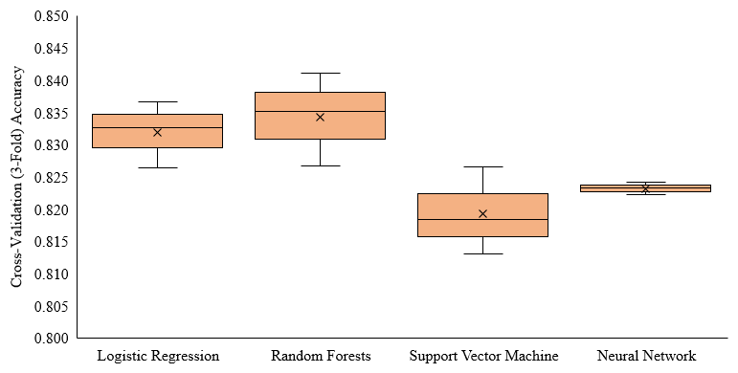
Models Performances
All models implemented in Python using Scikit-learn package
3-Fold Cross-validation; Scored by accuracy ( $\frac{Σ True positive + Σ True negative}{Σ Total samples}$ )
Average CV accuracy
Logistic Regression: 0.832
Random Forests: 0.834
SVM: 0.819
Neural Network: 0.823

Slide 24
Cytochrome P450 3A4 Inhibitor Modeling
Standard Models
Retrieve AID: 1851
using PubChem API
Mordred
Generate Features
PubChem Fingerprints
Clean and Label Data
Imputation
Hyperparameter Optimization
Normalization
Low Variance Removal
Class Balance
Logistic Regression
Train Models
Support Vector Machine
Random Forests
Neural Network
Novel Models
SMILE Auto-Extraction
Train Models
2D Auto-Extraction

Slide 25
SMILES String Auto-Extraction
SMILES strings are encoded into numerical matrices
 | N | C | C | C | N | C | C | S | P | ( | = | O | ) | ( | O | ) | O
# Hydrogens | 2 | 2 | 2 | 2 | 1 | 2 | 2 | 0 | 0 | 0 | 0 | 0 | 0 | 0 | 1 | 0 | 1
Degree | 3 | 4 | 4 | 4 | 3 | 4 | 4 | 2 | 4 | 0 | 0 | 1 | 0 | 0 | 2 | 0 | 2
Formal Charge | 0 | 0 | 0 | 0 | 0 | 0 | 0 | 0 | 0 | 0 | 0 | 0 | 0 | 0 | 0 | 0 | 0
Valence | 3 | 4 | 4 | 4 | 3 | 4 | 4 | 2 | 5 | 0 | 0 | 2 | 0 | 0 | 2 | 0 | 2
In Ring | 0 | 0 | 0 | 0 | 0 | 0 | 0 | 0 | 0 | 0 | 0 | 0 | 0 | 0 | 0 | 0 | 0
Aromatic | 0 | 0 | 0 | 0 | 0 | 0 | 0 | 0 | 0 | 0 | 0 | 0 | 0 | 0 | 0 | 0 | 0
C | 0 | 1 | 1 | 1 | 0 | 1 | 1 | 0 | 0 | 0 | 0 | 0 | 0 | 0 | 0 | 0 | 0
N | 1 | 0 | 0 | 0 | 1 | 0 | 0 | 0 | 0 | 0 | 0 | 0 | 0 | 0 | 0 | 0 | 0
O | 0 | 0 | 0 | 0 | 0 | 0 | 0 | 0 | 0 | 0 | 0 | 1 | 0 | 0 | 1 | 0 | 1
Br | 0 | 0 | 0 | 0 | 0 | 0 | 0 | 0 | 0 | 0 | 0 | 0 | 0 | 0 | 0 | 0 | 0
Cl | 0 | 0 | 0 | 0 | 0 | 0 | 0 | 0 | 0 | 0 | 0 | 0 | 0 | 0 | 0 | 0 | 0
F | 0 | 0 | 0 | 0 | 0 | 0 | 0 | 0 | 0 | 0 | 0 | 0 | 0 | 0 | 0 | 0 | 0
P | 0 | 0 | 0 | 0 | 0 | 0 | 0 | 0 | 1 | 0 | 0 | 0 | 0 | 0 | 0 | 0 | 0
S | 0 | 0 | 0 | 0 | 0 | 0 | 0 | 1 | 0 | 0 | 0 | 0 | 0 | 0 | 0 | 0 | 0
ring | 0 | 0 | 0 | 0 | 0 | 0 | 0 | 0 | 0 | 0 | 0 | 0 | 0 | 0 | 0 | 0 | 0
( | 0 | 0 | 0 | 0 | 0 | 0 | 0 | 0 | 0 | 1 | 0 | 0 | 0 | 1 | 0 | 0 | 0
) | 0 | 0 | 0 | 0 | 0 | 0 | 0 | 0 | 0 | 0 | 0 | 0 | 1 | 0 | 0 | 1 | 0
/ | 0 | 0 | 0 | 0 | 0 | 0 | 0 | 0 | 0 | 0 | 0 | 0 | 0 | 0 | 0 | 0 | 0
\ | 0 | 0 | 0 | 0 | 0 | 0 | 0 | 0 | 0 | 0 | 0 | 0 | 0 | 0 | 0 | 0 | 0
= | 0 | 0 | 0 | 0 | 0 | 0 | 0 | 0 | 0 | 0 | 1 | 0 | 0 | 0 | 0 | 0 | 0
# | 0 | 0 | 0 | 0 | 0 | 0 | 0 | 0 | 0 | 0 | 0 | 0 | 0 | 0 | 0 | 0 | 0
Counter Clockwise Chirality | 0 | 0 | 0 | 0 | 0 | 0 | 0 | 0 | 0 | 0 | 0 | 0 | 0 | 0 | 0 | 0 | 0
Clockwise Chirality | 0 | 0 | 0 | 0 | 0 | 0 | 0 | 0 | 0 | 0 | 0 | 0 | 0 | 0 | 0 | 0 | 0
SP | 0 | 0 | 0 | 0 | 0 | 0 | 0 | 0 | 0 | 0 | 0 | 0 | 0 | 0 | 0 | 0 | 0
SP2 | 0 | 0 | 0 | 0 | 0 | 0 | 0 | 0 | 0 | 0 | 0 | 1 | 0 | 0 | 0 | 0 | 0
SP3 | 1 | 1 | 1 | 1 | 1 | 1 | 1 | 1 | 1 | 0 | 0 | 0 | 0 | 0 | 1 | 0 | 1
Ring Start | 0 | 0 | 0 | 0 | 0 | 0 | 0 | 0 | 0 | 0 | 0 | 0 | 0 | 0 | 0 | 0 | 0
Ring End | 0 | 0 | 0 | 0 | 0 | 0 | 0 | 0 | 0 | 0 | 0 | 0 | 0 | 0 | 0 | 0 | 0

Slide 26
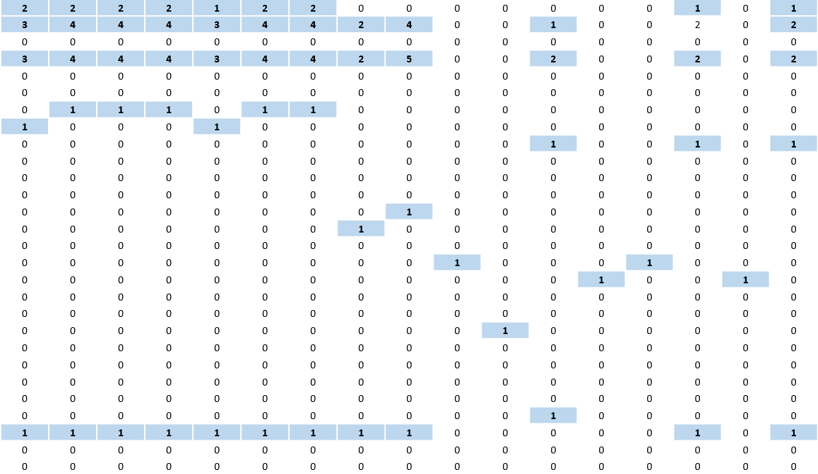
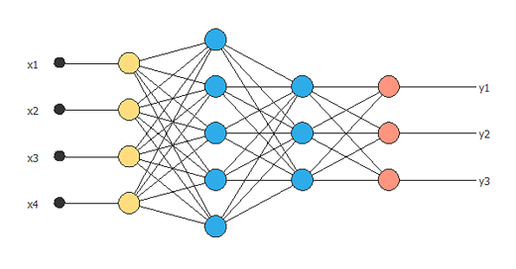
SMILES String Auto-Extraction
1D convolutional layers scan SMILES, pooling and filtering the numeric vectors
…
First Convolution
Further Convolutions
Dense Layers

Slide 27
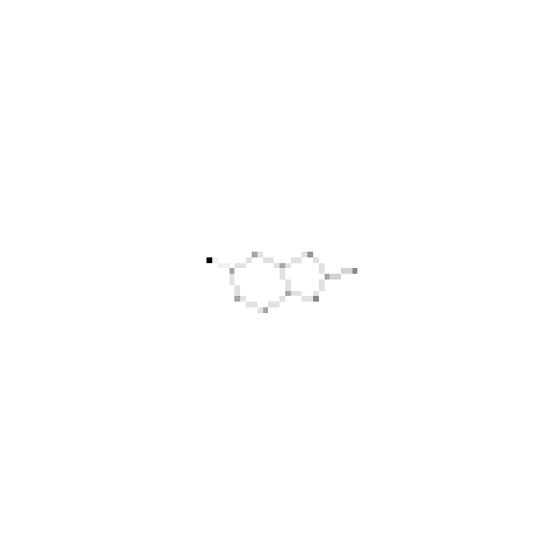
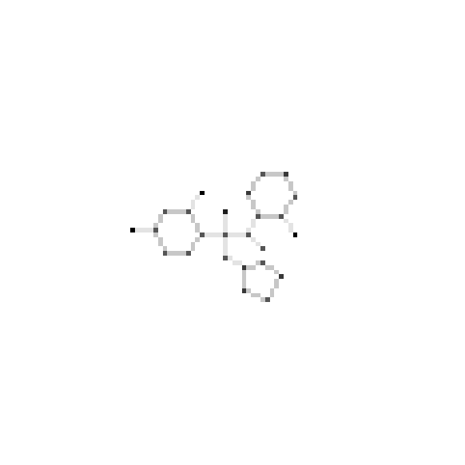
2D Structure Auto-Extraction
2D Conformations generated from SMILES string with RDKit package
Atom positions (measured in ångströms) can placed into a pixel matrix
Bond pixels can be calculated using Bresenham's line algorithm
Atom’s encoded by atomic mass and bonds encoded by bond order
Placed into different filters to make a 100x100x2 matrix
Chlorzoxazone
Voriconazole

Slide 28
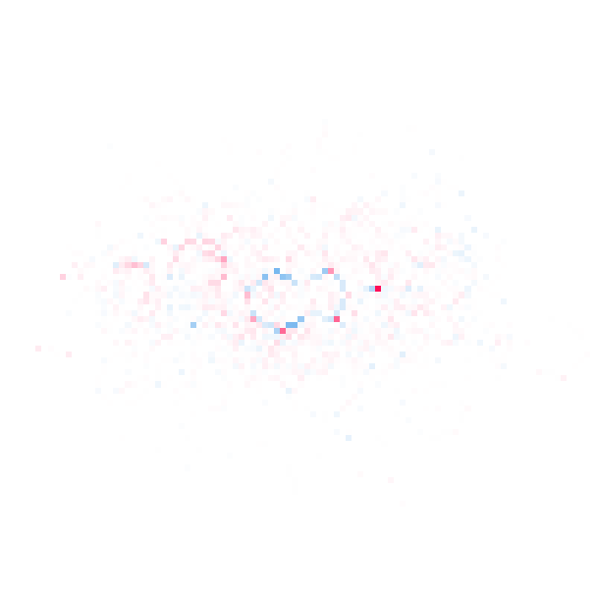
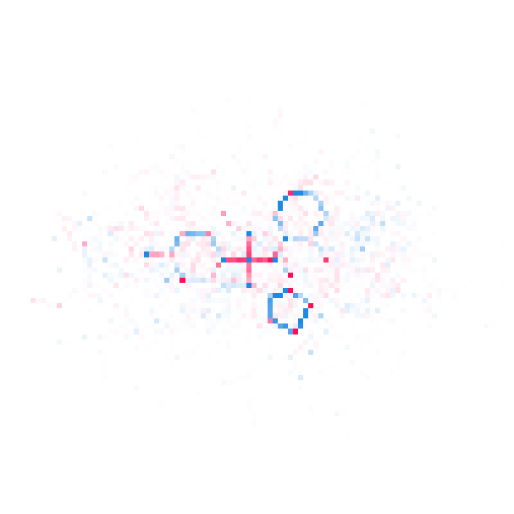
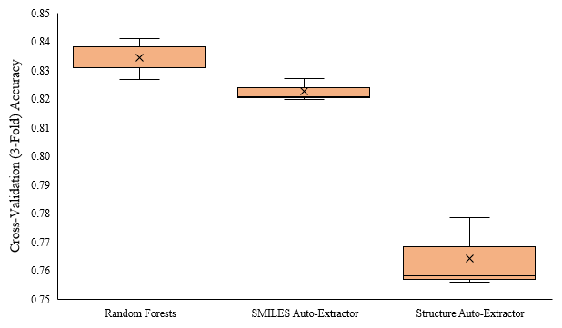
2D Structure Auto-Extraction
2D convolutional layers scan across the x, y dimensions, pooling and filtering the atom and bond filters
Chlorzoxazone
Voriconazole
-0.02 -0.01 0.00 0.01 0.02
SHAP Value

Slide 29
Validation on Known CYP3A4 Inhibitors*
Boceprevir
Cobicistat
Ketoconazole
Posaconazole
Ritonavir
Telaprevir
Telithromycin
Troleandomycin
Voriconazole
Aprepitant
Ciprofloxacin
Conivaptan
Crizotinib
Cyclosporine
Diltiazem
Dronedarone
Erythromycin
Fluconazole
Fluvoxamine
Imatinib
Tofisopam
Verapamil
Chlorzoxazone
Cilostazol
Cimetidine
Clotrimazole
Fosaprepitant
Istradefylline
Ivacaftor
Lomitapide
Ranitidine
Ranolazine
Ticagrelor
0.76 | 0.82 | 0.33 | 0.40 | 0.06 | 0.38
0.43 | 0.04 | 1.00 | 0.59 | 0.38 | 0.83
0.27 | 0.62 | 0.99 | 0.60 | 0.82 | 0.81
0.58 | 0.06 | 0.70 | 0.45 | 0.23 | 0.23
0.22 | 0.00 | 0.97 | 0.53 | 0.25 | 0.52
0.36 | 0.01 | 0.62 | 0.45 | 0.07 | 0.64
0.45 | 0.17 | 0.99 | 0.36 | 0.05 | 0.02
0.91 | 0.99 | 0.70 | 0.66 | 0.95 | 0.20
0.13 | 0.41 | 0.67 | 0.40 | 0.06 | 0.11
0.45 | 0.49 | 0.51 | 0.47 | 0.21 | 0.56
0.90 | 0.92 | 0.00 | 0.06 | 0.02 | 0.00
0.68 | 0.42 | 0.95 | 0.63 | 0.04 | 0.74
0.20 | 0.38 | 0.98 | 0.46 | 0.18 | 0.56
0.84 | 0.99 | 0.63 | 0.66 | 0.95 | 0.25
0.11 | 0.59 | 0.97 | 0.63 | 0.87 | 0.56
0.44 | 0.06 | 0.64 | 0.48 | 0.26 | 0.20
0.89 | 0.99 | 0.20 | 0.13 | 0.21 | 0.01
0.48 | 0.46 | 0.17 | 0.26 | 0.08 | 0.28
0.94 | 0.90 | 0.77 | 0.63 | 0.93 | 0.27
0.35 | 0.28 | 0.58 | 0.47 | 0.02 | 0.18
0.47 | 0.54 | 0.86 | 0.51 | 0.16 | 0.57
0.39 | 0.11 | 0.83 | 0.54 | 0.88 | 0.61
0.96 | 0.99 | 0.02 | 0.10 | 0.03 | 0.04
0.82 | 0.35 | 0.82 | 0.53 | 0.37 | 0.26
0.94 | 0.37 | 0.38 | 0.23 | 0.07 | 0.05
0.33 | 0.22 | 0.99 | 0.68 | 0.82 | 0.85
0.24 | 0.60 | 0.16 | 0.43 | 0.17 | 0.44
0.69 | 0.58 | 0.89 | 0.45 | 0.24 | 0.29
0.61 | 0.73 | 0.20 | 0.27 | 0.04 | 0.07
0.39 | 0.14 | 0.93 | 0.57 | 0.27 | 0.80
0.91 | 0.91 | 0.02 | 0.01 | 0.02 | 0.04
0.71 | 0.87 | 0.61 | 0.34 | 0.09 | 0.18
0.65 | 0.93 | 0.70 | 0.36 | 0.07 | 0.03
Strong
Moderate
Weak
*https://www.fda.gov/drugs/drug-interactions-labeling/drug-development-and-drug-interactions-table-substrates-inhibitors-and-inducers
Structure | SMILES | LR | RF | SVM | NN

Slide 30
Conclusions and Opportunities
Models performed well (> 75% accuracy) at classifying inhibitors and non-inhibitors
Random forests, logistic regression, and SMILES auto-extraction performed the best
Accuracies between 82.3% - 83.4%
Modeling methods can be modified to learn and predict any activity for any target
Expand from binary to multiple labels, e.g. strong, medium, or weak inhibitors
Discover important substructures by exploring weights in SMILES auto-extractor or 2D auto-extractor models
Tool that generates compound derivates from a parent compound, predicting CYP3A4 inhibition potential
Score each derivative and display them to a chemist for further considerations

Slide 31
Acknowledgements
My thesis committee for their countless hours helping, teaching, and guiding me
Dr. Serhiy Hnatyshyn
Dr. Vasil Hnatyshin
Dr. Umashanger Thayasivam
All the great professors at Rowan who have shaped me along the way
Scientists at Bristol-Myers Squibb for supporting my research
My friends and family for always sticking by me

